Slide 1
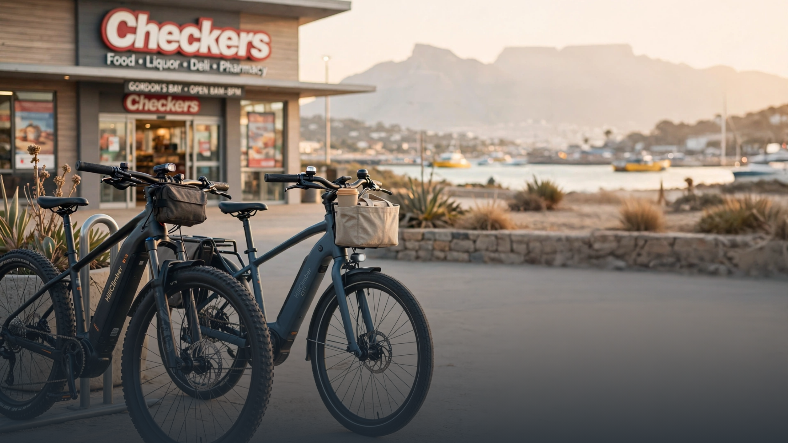
OpenKM — Low-Data Translator for Transport

Slide 2
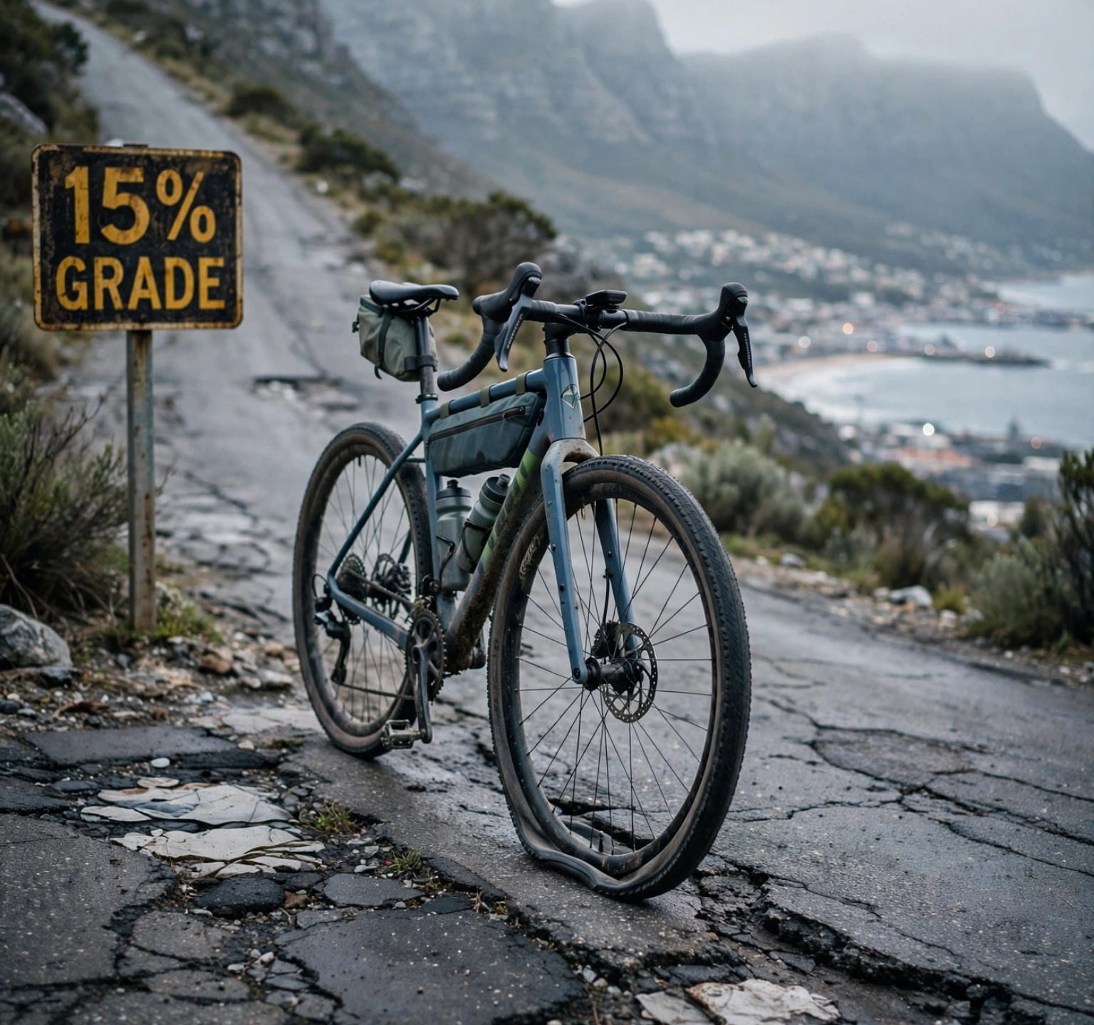


The gap in Cape Town mobility
Informal feeders lose 25% downtime to punctures, no data, no safety net. City needs integration without owning the fleet.
Mountainside 15% grades kill cheap e-bikes — motor overheat, battery stranded at 60%
Punctures = rider stuck on Mountain Road, no roadside repair, taxi rank missed
MyCiTi feeder gap 0.8-2km uncovered, taxi queue risky after dark
No open km standard to calculate cost per km or side-road patch savings
25%downtime today
0open km audited
15%grade barrier

Slide 3









Solution is a translator, not another fleet
open km = base × method × fuel index
Low-data SQLite + GPS. Works offline, syncs at hub WiFi. Any network translated to same cost per km. City pays per feeder km, not per bike.
Support not own — Gordon's Bay pilot at Checkers hubs. One open km standard that translates informal, e-bike, MyCiTi, taxi and fuel costs to patch side roads and fund safe feeder hubs.
Low-data SQLite core
Checkers hub share
Support not own jobs
2-sec GPS ping, offline cache, 14kb per trip. No signal needed at rank. Anonymous ID, 100m rounding for privacy.
Solar LED, CCTV, security, roof already paid. DropBox bolted to wall, battery cabinet metal ventilated. No new build.
Time Controller = TapCard agent + maintenance + safety trainer. Taxi rank partnership not competition. 3 jobs per hub.
Offline-first
IP65 sealed
5 sites ready
Shared cost
Micro-enterprise
15-min onboard

Slide 4




Fleet dual — built for Gordon's Bay
HillClimber for Mountainside, CiTiDriver for flat MyCiTi feeders. Same OS, same odometer, same safety.
HillClimber
Mountainside
15% GRADE
CiTiDriver
Feeder
0.8-2KM FLAT
26" 85Nm mid-drive, 625Wh + spare, motor derate 80°C
700c 65Nm, 625Wh, efficient on flat MyCiTi
180mm hydraulic disc, low-gear both-brakes weight-back protocol
160mm hydraulic, weekly QR log, brake cut-off
Tannus 100% airless puncture proof, 5,000km rated
Tannus airless — 0 roadside repairs, 300 days
Hall sealed IP65 + OpenKM GPS dual odometer
Same dual odometer, same ESP32-S3 AI brain
Wet Grip StrapOn compatible — 60-sec V-tread
CiTi sleeve Wet Grip — for winter slick
10 units pilot
Swap at hub
10 units pilot
25 km/h cap legal
Common: Helmet + high-vis + 400 lumen always-on • Spoke reflectors • Tilt sensor • 2x security shared Checkers
Both NFC PN532 0.2s

Slide 5







Safety measurements enable scale — City approval requirement. No open km released without training flag and QR log.
Safety is infrastructure
Rider
15-min
Bike
IP65
Helmet, high-vis, 400 lumen always-on
180/160mm hydraulic, weekly QR log
25 km/h cap SA legal, training flag required
Brake cut-off + tilt sensor, spoke reflectors
No unlock on 15% grade without Hill pass
Tannus airless — no roadside repair needed
Hill
Auto-cut
Hub
Checkers
Low gear, both brakes, weight back protocol
2× security shared Checkers, CCTV solar
20% speed cut in rain via weather API
Battery cabinet metal ventilated + smoke + extinguisher
Motor derate at 80°C, walk assist above 15%
First aid, emergency button, offline binder

Slide 6

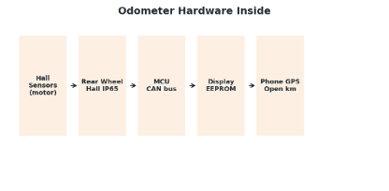





Odometer + AI chip inside display
Hardware km for service — sealed IP65 for False Bay salt. Open km for business — the translator City can audit. One display, two ledgers.
01
02
03
04
Hall sensors inside motor
MCU CAN bus → EEPROM
Display head + GPS open km
ESP32-S3 0.5W TinyML
3x Hall in mid-drive + rear wheel Hall backup. No spoke magnet to lose. Sealed IP65 against salt spray.
Controller converts pulses to km/h using wheel size (26” vs 700c). Total km stored in EEPROM, survives battery removal.
Hardware odo on screen + phone GPS SQLite logs open km offline. Drift check flags maintenance.
Inside display: BLE + PN532 NFC same board. Runs 4 brains offline, 0.5W from 36V buck.
Pulse source • 1 rotation = 1 count
Service ledger
Audit = HW vs GPS
Phase1 phone NPU, Phase2 open display
Hill brain
Wet slip brain
Maintenance brain
Theft brain
Torque + gradient, derate at 80°C, low gear prompt
Wheel vs GPS slip detection → Wet Kit + 20% cap
Vibration + odo predicts pads, Tannus 5k km, chain
Accel movement when locked → buzz hub security

Slide 7
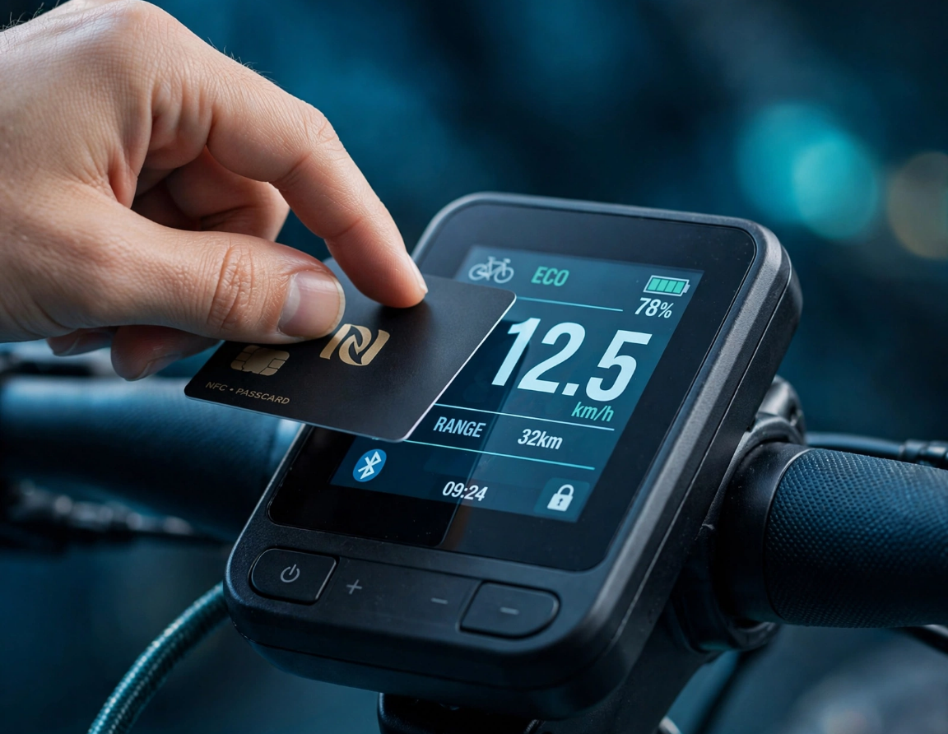






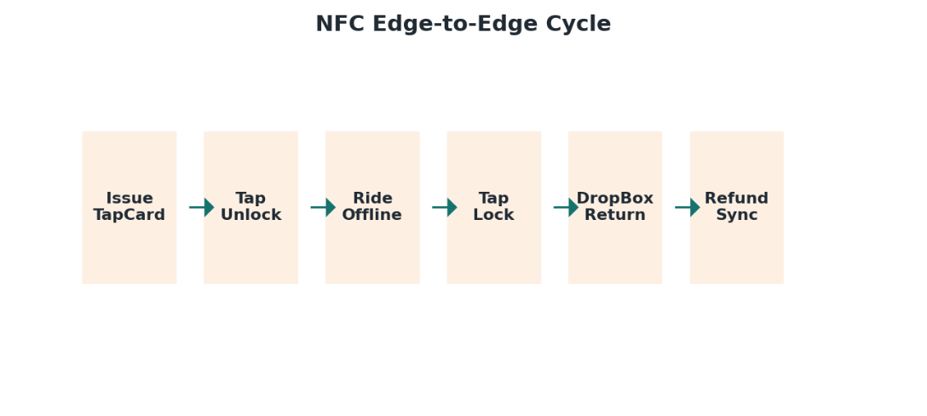




Wet grip loses,
StrapOn fixes it. NFC makes it offline
Airless Tannus is puncture-proof but loses wet grip — Mountainside rain needs extra bite. Hub issues kit, NFC logs it.
Wet Kit — extra grip strap-on
Nylon straps + cleated nails with 45a durometer glue-like rubber over 60a base, double-sided V-tread grips tyre + ground. 60-sec clip-on for 26" HillClimber, sleeve for 700c CiTiDriver. Stored at hub, issued when rain >70% via weather API.
reusable
roll without damage
20% speed cut auto
ISSUE → UNLOCK → RIDE OFFLINE → LOCK → HUB SYNC
NFC edge-to-edge cycle
Tap 0.2s PN532 → BLE handover ID + odometer + battery. Ride offline logging Hall sensors + GPS. No data at rank, sync later at Checkers hub WiFi. AI wet brain detects slip: wheel vs GPS.
PN532 0.2s
BLE offline
ESP32-S3

Slide 8
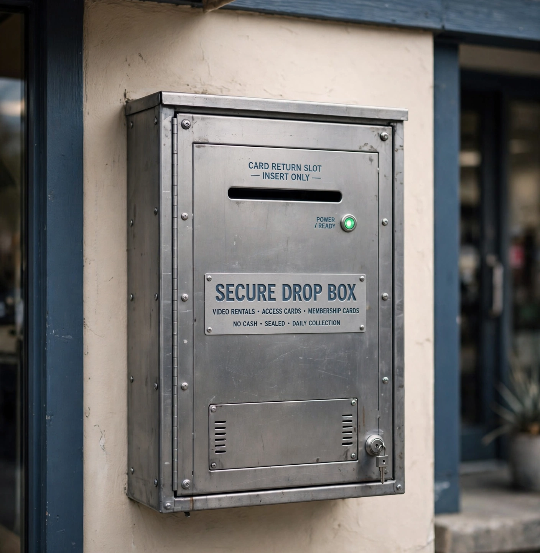



TapCard + DropBox — inclusive final lock
60% without NFC phones — deposit card makes Gordon's Bay cash-inclusive, DropBox closes the trust loop.
TapCard R12
DropBox R650
NTAG215 — last 10 trips
Steel Faraday cage grounded
Training flag + helmet size
Slot 86×2mm labyrinth 90° bend
Balance lives on tablet, not card
IR beam wakes PN532 2s only inside
Deposit R50 / Buy R80
Ferrite focus, RF 30% inward
No outward scanning: reader OFF until card breaks beam inside. Last TapReceiver writes RETURNED+LOCKED, drops to locked bin out of client hands. LED green = refund due.
Blockbuster BoxCard received — R50 refund at controller desk

Slide 9




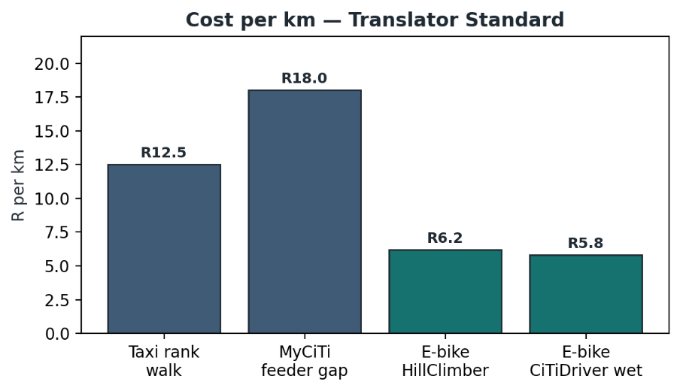










Business model — side roads funded by saved km
Cost per km translator funds infrastructure, not just rides. Fuel = 3× multiplier — e-bike wins, City saves, roads get patched.
COST PER KM — TRANSLATOR STANDARD
Formula
Savings engine
cost/km = base × method × fuel index
Taxi R12.5 walk, MyCiTi feeder R18.0 gap, HillClimber R6.2, CiTiDriver wet R5.8
300 days airless zero puncture downtime, 65 rainy days Wet Kit strap-on, motor derate saves battery. 0 roadside repairs.
Open standard
Auditable CSV
0 punctures
300 days
Revenue
Jobs — support not own
City: R6.2/feeder km per open km. Sixty60: km share per delivery. Deposit float R50 × 200 cards = R10k per hub.
Time Controller = TapCard agent + maintenance + safety trainer. 3 jobs per hub, 15 in pilot. Cash top-up, no bank needed.
MyCiTi
Sixty60
3× per hub
Cash inclusive

Slide 10










Gordon's Bay pilot — 5 hubs at Checkers
Start where Checkers already has security, solar, CCTV — share roof, share cost. Support not own.
Checkers hub network
5 SITES READY
90-day target — funded by saved km
Central Checkers
Mountainside
5,000 km
0
Gordon's Bay main, Time Controller desk
15% grade start, HillClimber base
feeder km audited open km standard
punctures — Tannus airless 300 days
Harbour
Strand
100%
50 m²
Tourist + feeder, wet kit issue
Flat CiTiDriver feeder link
safety onboarding + QR brake log
side-road patch funded by saved fuel
Somerset West rank
+ future infill
Data: anonymous trip ID, rounded 100m, export CSV for City, open source audited. No PII on card — balance on tablet only. ai.studio dashboard for City + Checkers + Sixty60.
Taxi rank partnership, not competition
Open km data decides next patch
20
5
200
2
bikes
10 Hill + 10 CiTi
DropBoxes
steel Faraday
TapCards
R50 deposit
Cabinets
metal ventilated
Solar LED
CCTV share
Jobs 3/hub

Slide 11


Ask — partnership, not procurement
What we need to launch Gordon's Bay in 30 days — no fleet ownership, just open km integration.
City of Cape Town
Checkers
Sixty60
Approval for 5 Checkers hubs + feeder km rate per open km standard. Anonymous 100m CSV export.
Share security / CCTV / solar at 5 sites, allow DropBox bolt (86mm slot). No new build.
4 Rider Cards, spare battery swap agreement, delivery km share for side-road fund.
OpenKM delivers:
10 HillClimber + 10 CiTiDriver • 5 DropBoxes • 200 TapCards • 2 charging cabinets • ai.studio dashboard
Jobs training + open data audited

